Slide 1

Hamster Capstone Final Testing Results🐭
by: Jared Hemauer, Rylee Horney, Keenan Keams, Joseph Lopez

Slide 2

Customer Requirements
CR 1. Size – the client wants the device to be small enough that it is portable and can move over the surface of a desk.
CR 2. Speed – the device will need to be able to reach a speed of up to 1 m/s in any direction. This is to allow for the device to keep up with a patient’s hand speed.
CR 3. Force – must be able to produce a force of up to 10 N to the patient’s hand in any direction or 5 Nm of torque about the vertical axis.
CR 4. Internal Friction – when motors are not being used the device must be able to be moved with less than 5N of force.
CR 5. Backlash- when motors are off the device must not move more than 0.1mm.
CR 6. Run Time – the device must run for at least 30 minutes on a single charge.
CR 7. Interface: device must be able to receive commands from a computer and send its position back to the computer in (x, y) coordinates.
CR 8. Screen – there must be a touch screen that is at least four inches on the device.
CR 9. Cost – total production of the device must be <$500.
CR 10. Microcontroller – client prefers Raspberry Pi to be used due to faster processing speeds.
CR 11. Ease of Use – should not require more than a number for the force being applied and a direction.
CR 12. Comfortable – the device should be comfortable in a patient’s hand.

Slide 3
Engineering Requirements
ER1- Motor Torque (Nm) – the motor must be able to produce enough torque to output a force of 10N on the patient’s hand.
ER2- Battery Life (kW hr ) – needs to last at least 30 minutes under load.
ER3- Battery Amperage (A) - need to be able to produce enough current for all components in the robot at least 6 Ah (i.e. three motors, raspberry pi, sensors, motor controller, and screen)
ER4- Size (ft) – less than 1ftx1ftx1ft
ER5- CPU Speed (s) – the microcontroller needs to be able to send commands quickly so there is minimal delay in the movement of the robot. (16 MHz)
ER6- Weight (lb.) - less than 10lbs

Slide 4
Testing Summary
Test # | Requirements Being Tested | Equipment Needed | Other Resources
1. Prony Brake | CR2: Speed of 1m/s CR3: Produce 10N of force ER1: Output a force of 10N | Spring scales, leather strap, 3D printed drum, tachometer | Thermal Fluids Lab (Rm 111)
2. Force Output Test | CR3: Produce 10N of force CR4: Internal friction of 5N or less | Digital scale | Raz Lab (ROTC 137)
3. Duration | CR6: Run for 30 minutes on a single charge ER2: Battery life at least 30 minutes ER3: Produce enough current for all components | Timer | Testing Space
4. Position Test | CR5: Move less than .1mm when motors are turned off CR7: Receive commands from the computer and return x,y coordinates | Tape measure | Testing Space

Slide 5
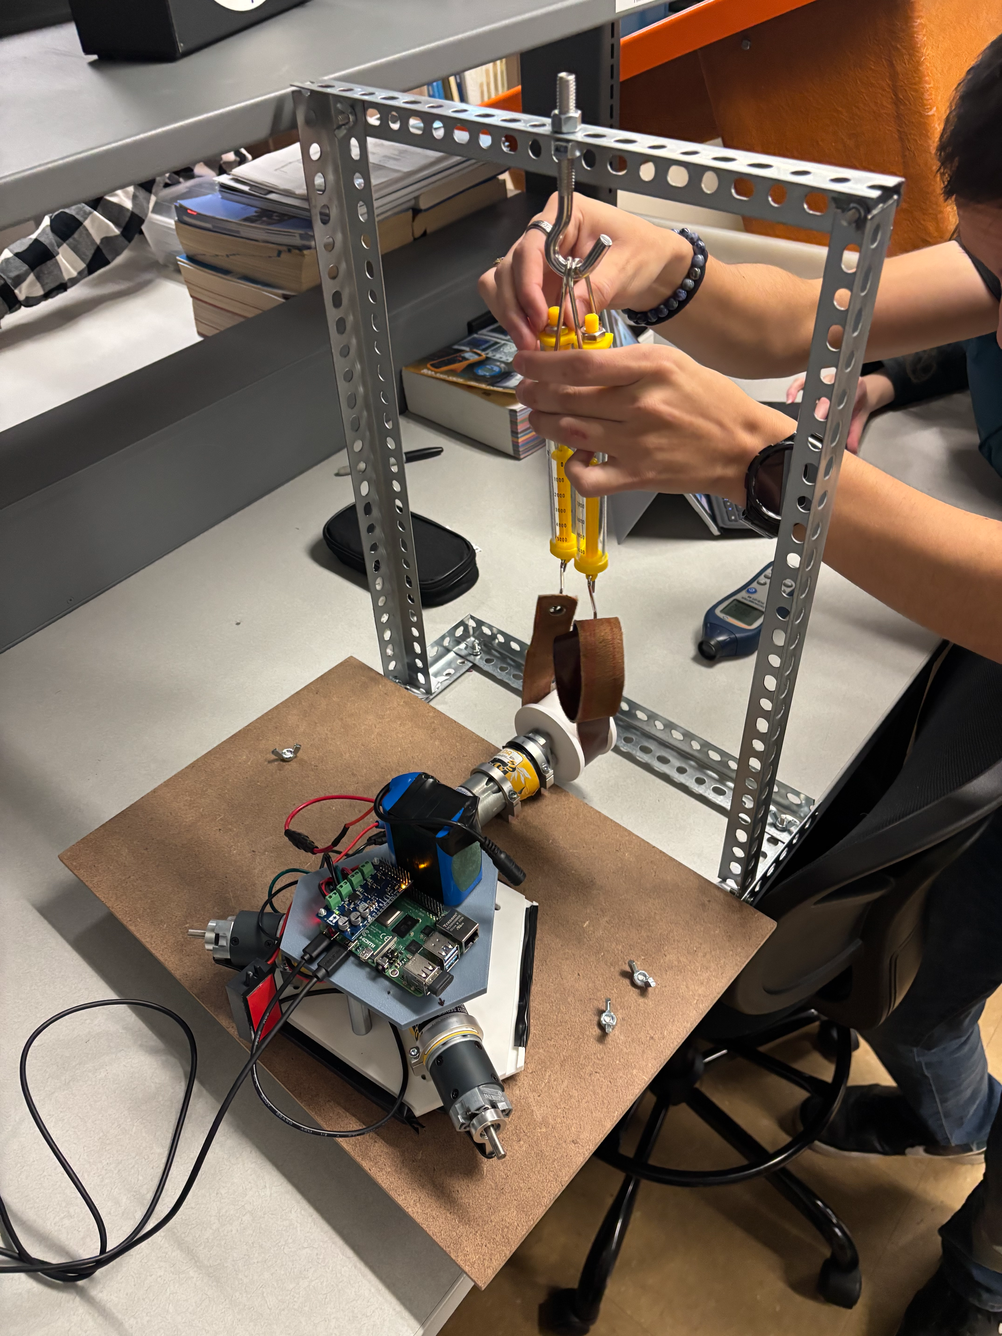
Prony Brake
Procedure
Fix Prony Brake onto the motor shaft.
Gradually apply force to the motor while running it at various amounts of current.
Record data and calculate variables using data.
Measure: Motor Torque Constant
Equipment: Prony Brake (Built), Tachometer, Computer
Results: Motor Torque Constant of 0.503 Nm/A
CR2: Speed of 1m/s
CR3: Produce 10N of force
ER1: Output a force of 10N

Slide 6
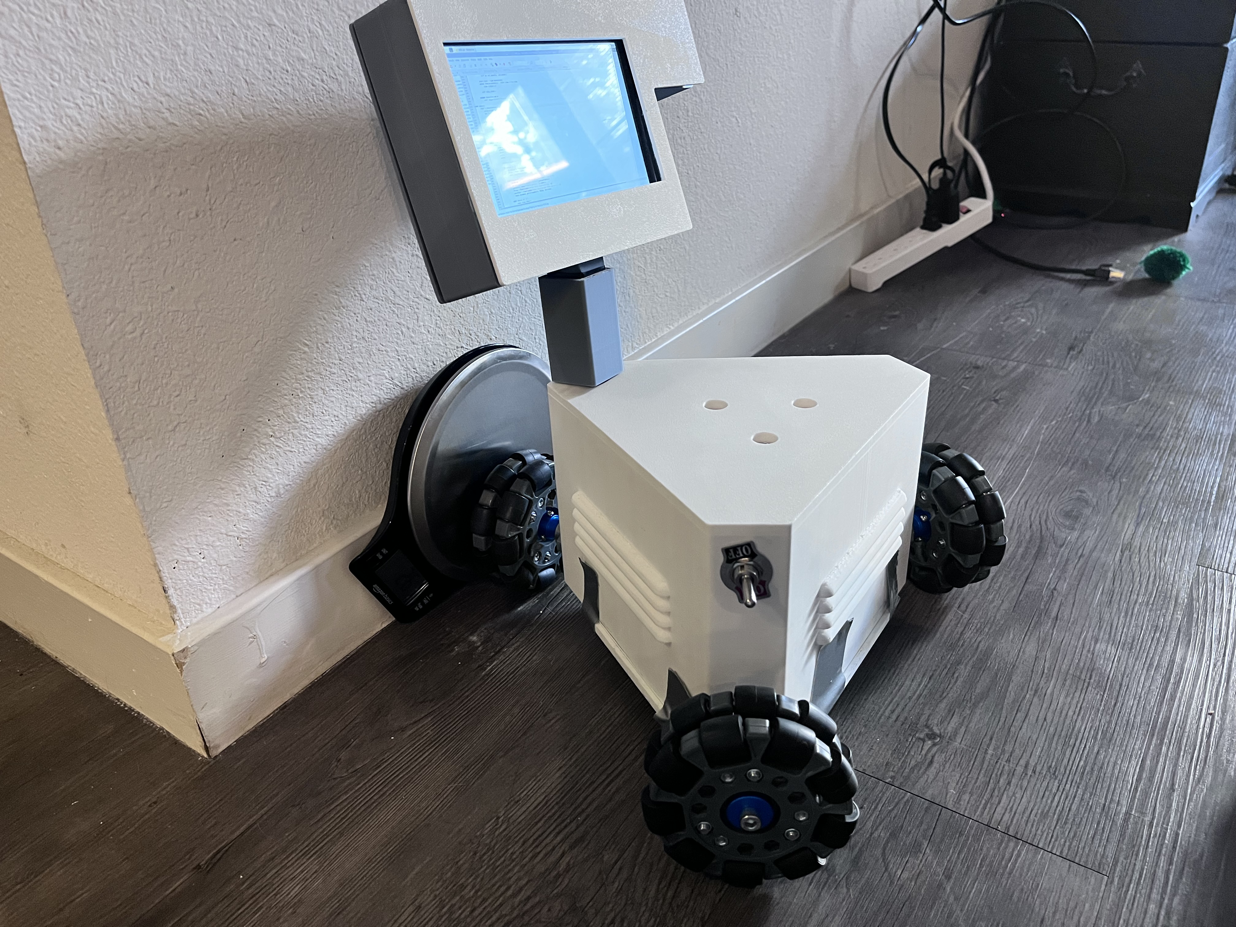
Force Output Test
Procedure
Place the device up against the digital scale
Input a desired output force into the UI
Read the output force from the spring scale
Repeat steps 2 & 3 to prove force calculations are accurate
Measure: Output force
Equipment: Digital scale
Results: The output force was within 2N of the input force
CR3: Produce at least 10 Newtons of force in any direction
CR4: When the motors are turned off the device should be able to be moved to 5 Newtons or less
ER7: Force Accuracy of 10 N +/- 1 N
Jared

Slide 7
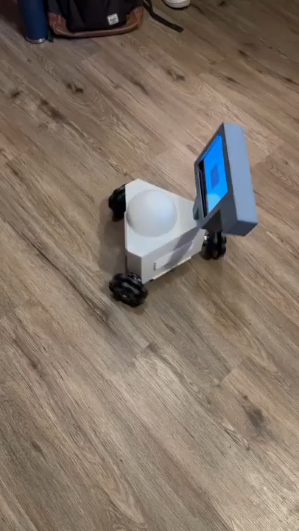
Duration Test
Procedure
Place the robot in an open space.
Set robot to turn in place indefinitely
Set a timer for 30 minutes
Measure: Time
Equipment: Timer
Results: The device ran for 30 minutes and showed no sign of slowing down
CR6: Run for 30 minutes on a single charge
ER2: Battery life at least 30 minutes
ER3: Produce enough current for all components in the robot at least 6 Ah
Jared

Slide 8
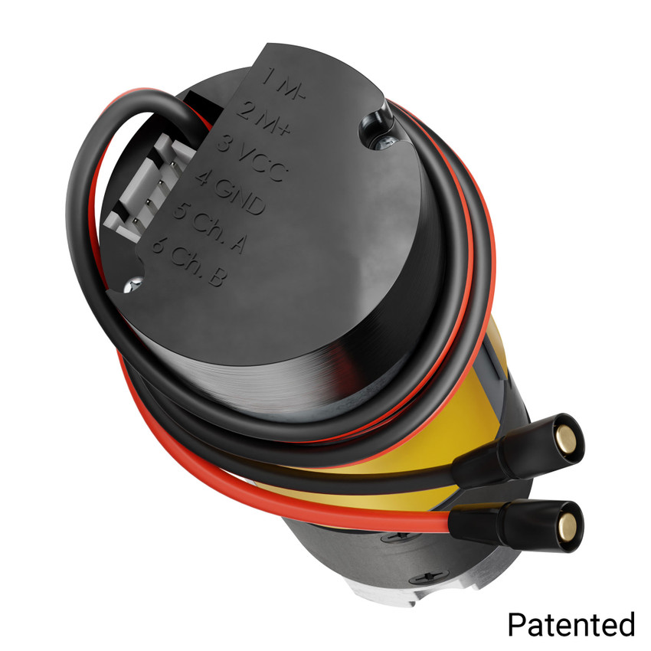
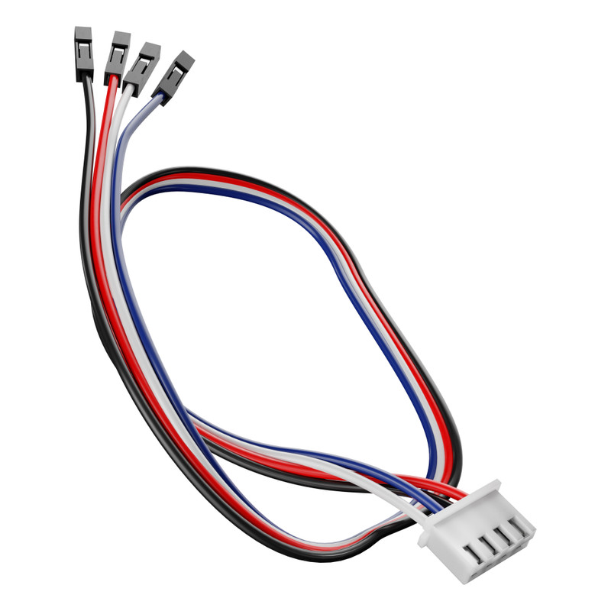
Position Test
Procedure
Develop code using encoders to determine the position of the motors
Lay measuring tape on the ground and place the robot on the zero mark
Input a distance to move in the UI
Measure the actual distance moved
Measure: Distance
Equipment: Tape measure
Results: Inconclusive
CR5: Move less than .1mm when motors are turned off
CR7: Receive commands from the computer and return x,y coordinates

Slide 9
Customer Requirements Met
Customer Requirement | CR Met? (Y or N) | Client Acceptable (Y or N)
CR 1- Size | Y
CR 2- Speed | Y
CR 3- Force | N
CR4- Internal Friction | N
CR 5- Backlash | N
CR 6- Run Time | Y
CR 7- Interface | N
CR 8- Screen | Y
CR 9- Cost | Y
CR 10- Microcontroller | Y
CR 11- Ease of Use | Y
CR 12- Comfortable | Y

Slide 10
Engineering Requirements Met
Engineering Requirement | Target | Tolerance | Measured/ Calculated Value | ER met? (Y or N) | Client Acceptable (Y or N)
ER 1- Motor Torque | 0.42 Nm | +/- 0.05 Nm | 2.4 Nm | Y
ER 2- Battery Life | 30 mins | +/- 5% of target | >30 mins | Y
ER 3- Battery Amperage | 6 Ah | +/- 5% | 6 Ah | Y
ER 4- Size | < 12in³ | +/- 2” for all | ~11in³ | Y
ER 5- CPU Speed | 16MHz | +/- 5% of target | 1.5 GHz | Y
ER 6- Weight | <10lbs | +/- 1 lb. | 10.7 lbs | Y
ER 7- Force Accuracy | 10 N | +/- 1 N | 10 +/- 2 N | N

Slide 11
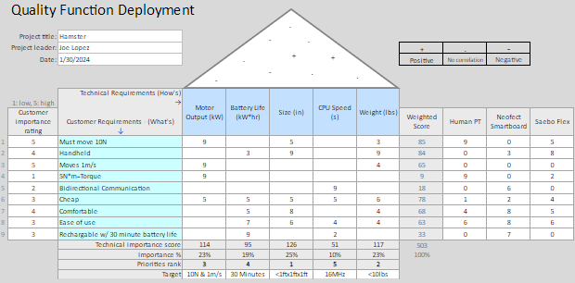
QFD

Slide 12
Thank you

